Slide 1
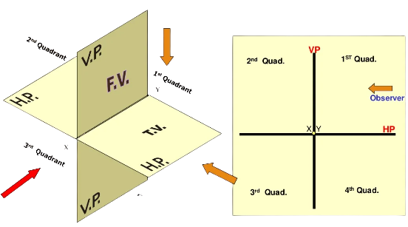
Projection of Points, Lines, and Planes
Prepared by:
Er. Bibek Magar
BE in Automobile Engineering
IOE, Thapathali Campus
bibek.magar@thc.tu.edu.np

Slide 2
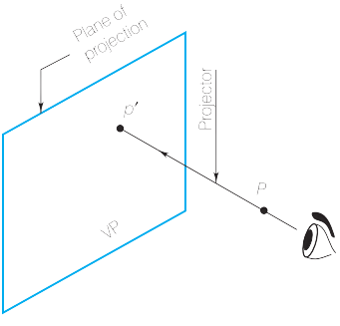
Orthographic Projection
If an observer, imagined to be positioned at infinity in front of a plane, looks at a point P with one eye, the line of sight joining the eye of the observer to the point P will be perpendicular to the plane and will meet the picture plane at point p′.
Point p′ is the view of point P and is known as its orthographic projection
The line of sight is known as the projector and the picture plane is called the plane of projection.
The projectors are always parallel with each other and perpendicular to the plane of projection.
p’
p

Slide 3

There are three mutually perpendicular principal planes used in Engineering drawing. They are Vertical Plane (VP), Horizontal Plane (HP), and Profile Plane (PP). However, for this lecture we are going to discuss only about the VP and HP.
2nd Quadrant
VP
1st Quadrant
2nd Quadrant
1st Quadrant
HP
FV
3rd Quadrant
4th Quadrant
TV
HP
3rd Quadrant
VP
4th Quadrant

Slide 4
Some standard notations used in Orthographic Projection.
A point in a three dimensional space is named using uppercase letters whereas it’s corresponding projection is named using lowercase letters.
A point projected on HP is represented only by it’s corresponding lowercase letter, however, the same point projected on VP is represented by lowercase letter followed by a single inverted comma. Also, the same point projected on PP (Profile Plane) is denoted by a double inverted comma. E.g. A point B is named as b on HP, b’ on VP, and b’’ on PP.
The line formed due to intersection of principal planes is called a reference line.
While depicting the planes three dimensional space, that is, quadrant, into a two dimensional space, HP is rotated by 90 degrees in clockwise direction.

Slide 5
Rotation of HP in 1st Quadrant:
VP
VP
HP
HP

Slide 6
Rotation of HP in 2nd Quadrant:
HP
VP
VP, HP

Slide 7
Rotation of HP in 3rd Quadrant:
HP
HP
VP
VP

Slide 8
Rotation of HP in 4th Quadrant:
HP, VP
VP
HP

Slide 9
Projection of Points
Projection of a point in the First Quadrant:
p’
p’
VP
P
HP
p
p

Slide 10
Projection of a point in the Second Quadrant:
Q
q
q
q’
q’
VP, HP

Slide 11
Projection of a point in the Third Quadrant:
r
r
HP
VP
R
r’
r’

Slide 12
Projection of a point in the Fourth Quadrant:
HP, VP
s’
s
s’
S
s

Slide 13
Projection of Lines

Slide 14
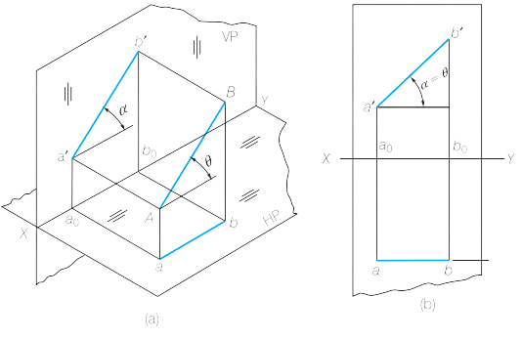
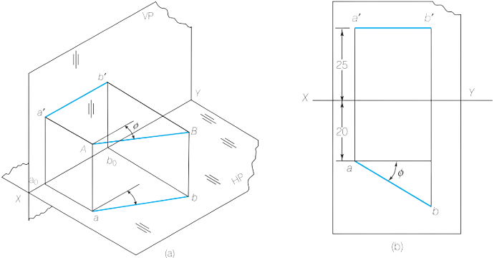
Projection of lines parallel to one of the principal planes while being inclined to another
When the line is parallel to the plane, then the projection of the line on that plane depicts the true length of the line, if not, then the projection is shorter than the true length

Slide 15
Projection of lines when the line is inclined to both of the reference planes
Line AB is parallel to VP and inclined to HP at an angle, so it’s projection of VP represents true length while projection on HP is shortened
VP
b’
b’
B
Keeping the angle with HP constant and making point A as a pivot point, line AB is inclined with VP at an certain angle.
B
a’
In this process two things are constant, the height of point B from HP and the length of projection of line AB on HP.
A
So, we can conclude from the observation that since the distance of point B from HP is constant unless the angle with HP is changed, the locus of projection of point B on VP must lie in a straight line.
b
a
b
HP

Slide 16
b’
b1’
b’
b1’
b’
X°
a’
X°
b2’
a’
a’
b1’
VP
b1
HP
a
b1
a
a
Y°
Y°
b
b
b1
b
b2
ab = ab1
a’b1’ = True Length = AB
a’b’ = a’b1’
ab1 = True Length = AB
a’b’ = a’b2’ = length of Front View
ab = ab1 = length of Top View
ab2 = a’b1’ = True Length = AB

Slide 17
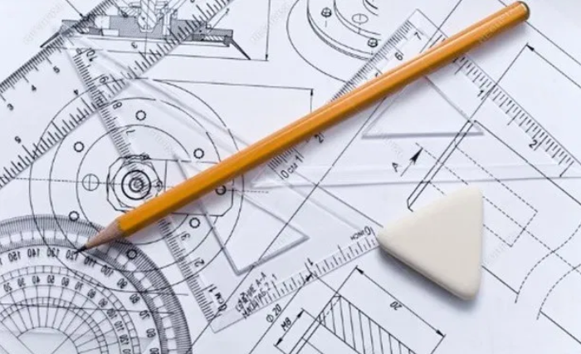
Solved Examples:

Slide 18
A straight line GH 60 mm long has its end G 10 mm above the HP and 12 mm in front of VP. Draw its projections when it is inclined to HP and VP at 42⁰ and 30⁰ respectively.
h'
h1'
g'
h2'
VP
g
HP
h1
h
h2

Slide 19
Points to remember:
This is an application of Revolution method, which can be used to find out the true length and inclination of the line.
While revolving the line such that it’s angle is kept constant, the height of the revolving end is constant, that is, the end of the projected view and the true length must lie on the locus of the revolving end of the line.
True length in top view can be obtained by making the front view parallel (by revolution) and vice versa.
The ends of the revolved line in both views should be collinear.
Revolving the front view, such that it is parallel to the reference line, gives us an end projector which must contain the true length of the line and vice versa.
h'
h1'
g’
h2'
g
h1
h
h2

Slide 20
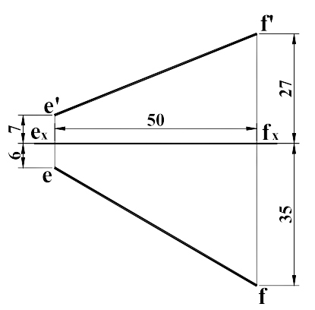
2) Determine the true length and true inclination of the line with VP and HP from the given projection using the revolution method.

Slide 21
General steps to find the true length using the “Revolution Method”:
Make on of the projected view parallel to the reference line, that is, pivot one end of the projected line and revolve the other end along the arc of radius which is equal to the length of that projected view.
Draw the projection line until it intersects the locus of the revolved point in the counter view.
Join the pivot point of the counter view and the point of intersection, and the length of the line drawn is the required true length.

Slide 22
f'
f2'
e2'
f'
f1'
e1'
e'
VP
e'
VP
HP
HP
e2
e
e
f2
f
f1
e1
f

Slide 23
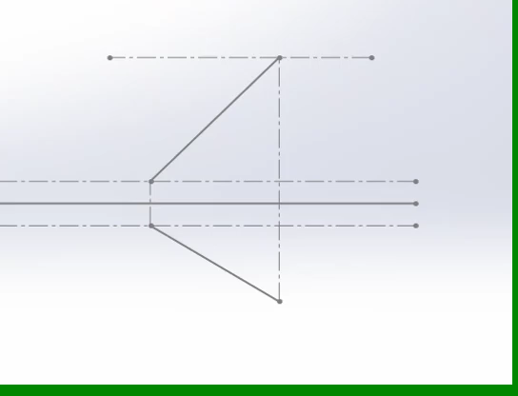
What are we actually doing??
We are simply making one of the projected views/lengths parallel with another plane such that the projected view on that plane represents the true length of the line.
Visualization is the main mantra of Engineering Drawing, so rather than playing with words, let’s watch the core principle of revolution method in an animated video.

Slide 24
3) Top View and front view of a straight line MN 60 mm long measures 50 mm and 40 mm respectively. One of it’s end is 15 mm above the HP and 10 mm in front of the VP. Draw its projections and determine its true inclination with VP and HP.
n'
n2'
m'n1' = m'n' = 40 = length of front view
m'n2' = mn1 = 60 = True length
34°
mn2 = mn = 50 = length of top view
m'
n1'
15
VP
10
HP
m
n2
48°
n
n1

Slide 25
4) Draw the projections of the line MN when its end M is 10 mm from HP and 15 mm from VP and end N is 30 mm from HP and 40 mm from VP. Its end projectors are 40 mm apart.

Slide 26
Projection of planes
In engineering drawing, an object is represented in two dimensions by drawing the orthographic projections of the boundary lines of its various surfaces. In a majority of cases, however, the surfaces of machine parts are plane surfaces with their boundary lines either polygonal or circular. It is, thus, really important to be able to understand and draw the projections of planes.
In this chapter the discussion is limited to the planes of triangular, rectangular, regular polygonal and circular shapes.
There are three positions that a plane can have. Depending upon the inclination of the plane with a reference plane, a given plane surface may be (i) parallel, (ii) perpendicular or (iii) inclined to the principal plane of projection.
A plane surface that has all the points on its surface at the same distance from a reference plane is said to be parallel to that reference plane.
A plane surface that has at least one line within it perpendicular to a reference plane is said to be perpendicular to that reference plane.
If a surface is neither parallel nor perpendicular to a reference plane, it is said to be inclined to that reference plane.
If a surface is inclined to both the reference planes, it is said to be an oblique plane.

Slide 27
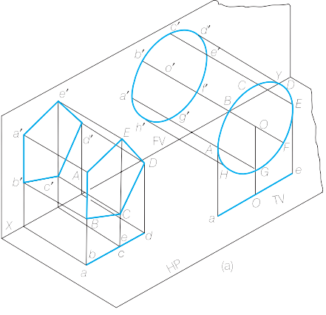
Case I: Planes parallel to VP

Slide 28
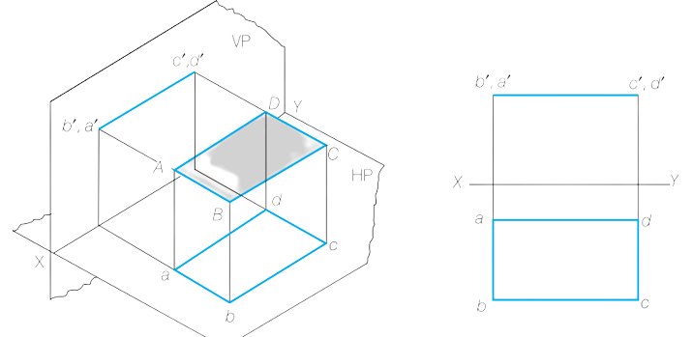
Case II: Planes parallel to HP

Slide 29
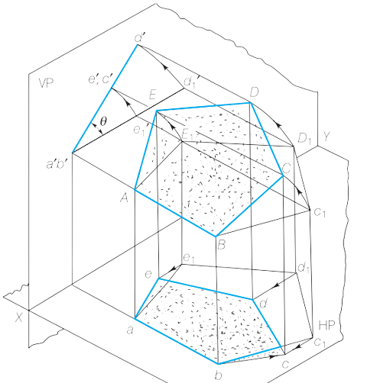
Case III: Planes perpendicular to one of the two principle planes while being inclined to the other

Slide 30
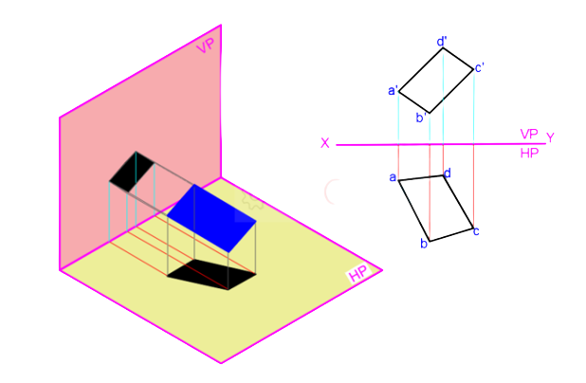
Case IV: Planes inclined to both reference planes

Slide 31
Solved Examples:

Slide 32
1) A rectangle ABCD 60 mm × 40 mm is parallel to HP with one of its sides inclined at 30⁰ to VP and the end of the side near to VP is 15 mm in front of the VP and 30 mm above the HP. Draw its projections.
d'
(a')
c'
b'
VP
a
HP
30°
b
d
c

Slide 33
2) A regular pentagon ABCDE, of 25 mm side, has its side BC in VP. Its plane is perpendicular to the HP and inclined at 45⁰ to the VP. Draw the projections of the pentagon when its corner nearest to HP is 10 mm from it.
e’
d’, (a’)
45°
HP
c’, (b’)
d’, (a’)
e’
c’, (b’)
VP
a1
a
b1
b
e1
e
c
c1
d1
d

Slide 34
3) Draw the projections of a thin circular sheet of 50 mm diameter and negligible thickness, when its plane is inclined at 45⁰ to VP and is perpendicular to HP. A point on it circumference and nearest to the VP is 40 mm away from the HP and 14 mm from the VP.
40
VP
14
HP
45°

Slide 35
4) A square ABCD of 50 mm side has its corner A in the H.P., its diagonal AC inclined at 30° to the H.P. and the diagonal BD inclined at 45° to the V.P. and parallel to the H.P. Draw its projections.
c1’
c’
d1’, (b1’)
30°
b’
a1’
d1’, (b1’)
c1’
a1’
d’
VP
a’
HP
b1
b2
b
c
a1
c1
a2
c2
a
45°
d
d1
d2

